Slide 1
A Heuristic Model to Solve Constraint Satisfaction Problem
Ryan Darras
Sudhanshu Semwal
Yanyan Zhuang
Tim Chamillard

Slide 2
Background
Constraint Satisfaction Problem (CSP)
Set of objects, set of constraints on objects
Solved state = every constraint is satisfied
High complexity
Requires heuristics and search algorithms
Heuristic
Improves algorithm performance
Not guaranteed to get optimal solution

Slide 3
Significance
CSPs are everywhere
Traveling Salesman Problem (TSP)
Job Shop Scheduling Problem (JSP)
Graph Coloring Problem (GCP)
Heuristics aren’t perfect
Song [1] looks at how to modify existing heuristics to be risk-resilient
Claim their results are effective, but not perfect

Slide 4
Limitations
Quality of testing applicants
Do we have a diverse enough set?
Quantity of testing applicants
Enough for a few sub groups?
Unrealistic to handle every CSP
Study a subset of diverse & popular CSPs

Slide 5
Purpose
To create a successful model for creating heuristics for CSPs.
We hypothesize that students using this model will produce more efficient heuristics while maintaining minimal error in accuracy.

Slide 6
How
Create simulation with state of the art algorithms to compare against.
Genetic algorithm to study which variables of system are most/least significant.
Develop & test model iteratively.
Start with one CSP, then apply to another.
Test with applicants.

Slide 7
Targeted CSPs
Traveling Salesman Problem
n Queens Problem
Graph Coloring Problem

Slide 8
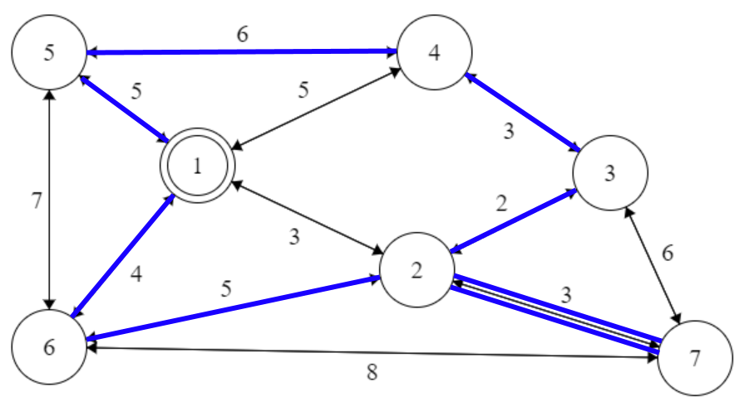
Traveling Salesman Problem
Heuristic Variables
Willingness to Backtrack
Determine bad path
Clustering
Algorithms
Bektas [2]
Notes:
Determine bad path – How far do we have to go while only visiting a certain amount of nodes before we have determined this was a bad route to take vs others?
Clustering – Organizing nodes in clusters like cities to optimize search

Slide 9
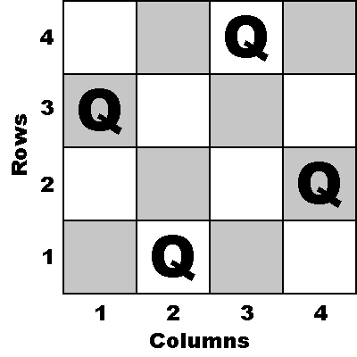
n Queens Problem
Heuristic Variables
Overlap
Nullification
Algorithms
Bell & Stevens [3]
Notes:
Overlap – How many nodes did I just nullify that were already nullified?
Nullification – How many nodes did I just nullify?

Slide 10
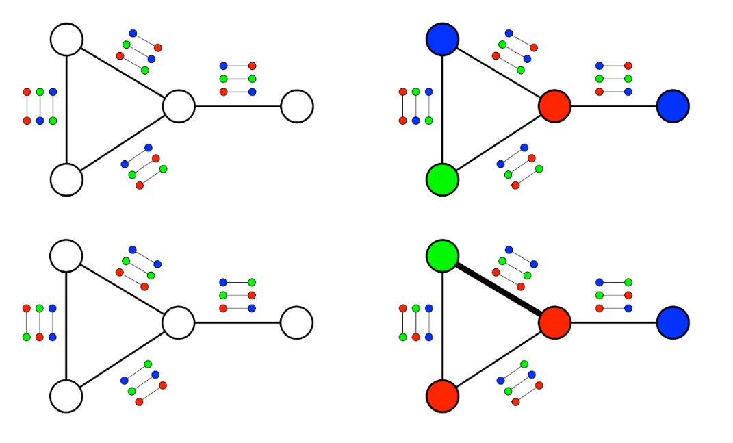
Graph Coloring Problem
Heuristic Variables
Color acceptance ranking
Node vulnerabilities
Algorithms
Moalic & Gondran [4]
Notes:
Color acceptance ranking – How many options does the given color have to be satisfied.
Node vulnerabilities – When do we consider a node to be vulnerable, and how do we handle that.

Slide 11
Evaluation Metrics
Time Complexity
seconds
Space complexity
# vertices
Accuracy
percentage of optimal
Ease of use
Estimation of model effectiveness for user

Slide 12
References
[1] S. Song, Kai Hwang and Yu-Kwong Kwok, "Risk-resilient heuristics and genetic algorithms for security-assured grid job scheduling," in IEEE Transactions on Computers, vol. 55, no. 6, pp. 703-719, June 2006. doi: 10.1109/TC.2006.89
[2] T. Bektas, “The multiple traveling salesman problem: an overview of formulations and solution procedures,” Omega, vol. 34, no. 3, pp. 209– 219, 2006.
[3] J. Bell and B. Stevens, “A survey of known results and research areas for n-queens,” Discrete Mathematics, vol. 309, no. 1, pp. 1–31, 2009.
[4] Laurent Moalic and Alexandre Gondran. 2017. Heuristic rope team: a parallel algorithm for graph coloring. In Proceedings of the Genetic and Evolutionary Computation Conference (GECCO '17). ACM, New York, NY, USA, 314-320. DOI: https://doi.org/10.1145/3071178.3071291

